Slide 1
NAME OF THE PROJECT Car Price Prediction
Submitted by:
Arshi Maitra

Slide 2
Acknowledgement:
This project has been completed with the help of training documents and live classes recordings from Data Trained Education. Few helps on coding have also been taken from few data science websites like Toward Data Science, Geek for Geeks, Stack Overflow. All data related to the car price has been taken from www.carwale.com

Slide 3
INTRODUCTION
Many used vehicles are sold each year . Effective pricing strategies can help any company to efficiently sell its products in a competitive market and making profit. In the automotive sector, pricing analytics play an essential role for and understanding the factors that determine the price of a car is a huge advantage for the seller. Below is a dataset used from www.carwale.com to find what are the different factors that determine the pricing of a car.
The main goal of the project will be to determine the following:
To determine the price of various cars in India
To understand the factors that are responsible for the price of a car

Slide 4
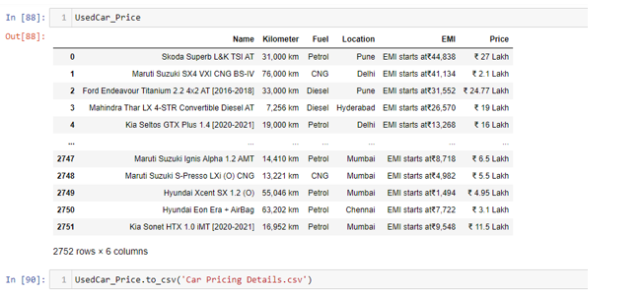
Analytical Problem Framing
Webscraping:
Before importing the necessary libraries for data analysis and prediction, the data has been first scrapped from the website www.carwale.com by using Selenium method from Webscraping. The data is saved in CSV which is later on used for analysis:

Slide 5
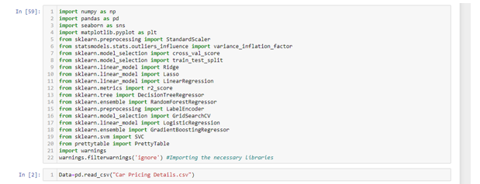
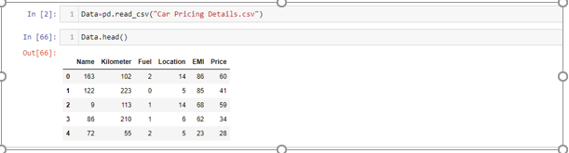
Importing Libraries:
Data preprocessing/Data Cleaning:

Slide 6

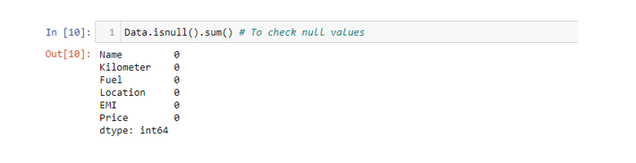
Going through the columns of the data: Checking the null values from Train and Test data:

Slide 7


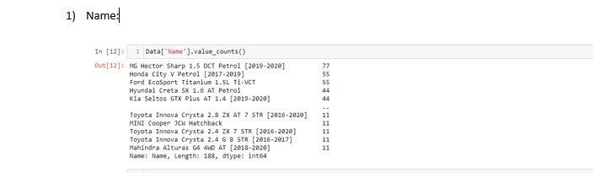
Dropping the null values as well as filling up the null values:
Encoding the object data types
Checking the feature data

Slide 8
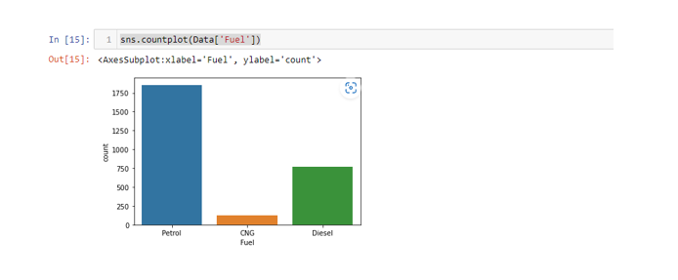
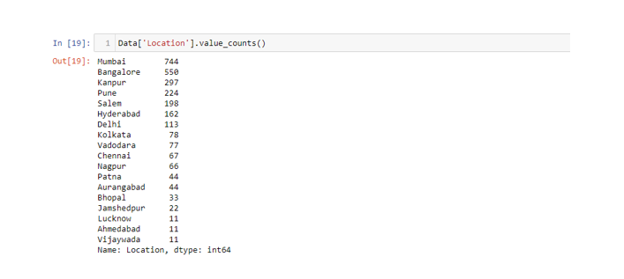
Fuel Type
Location
** Basic details identified are Maximum cars are sold from Mumbai with the brand name MC Hector sharp and majority cars has its fuel as petrol

Slide 9
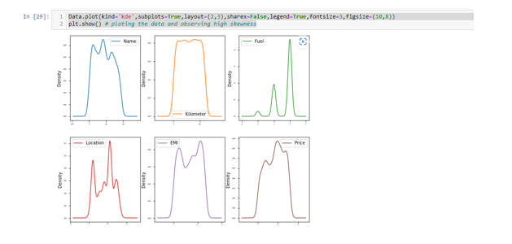
Checking Data Skewness :

Slide 10
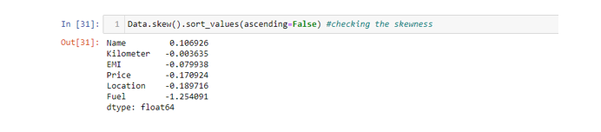
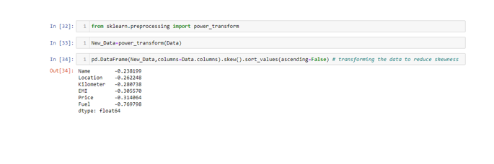
Skewness Score:
Importing Power Transformation.
As the data is skewed it will affect the prediction score. Therefore data has to be transformed before taking any further action:

Slide 11
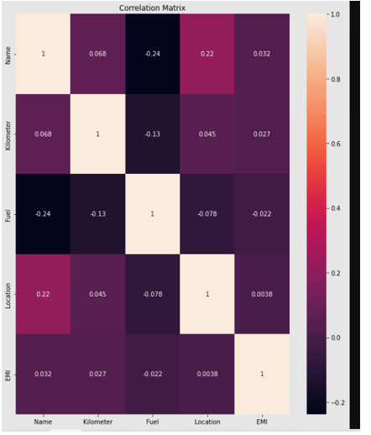
Checking Multicollinearity: 1. Heat Map:

Slide 12

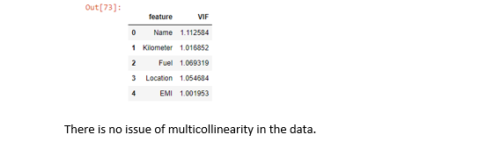
From the heat map it can be observed that basement quality and basement condition has 100 % multicollinearity issue. Therefore it needs to be dropped, lets check via another metric that is VIF. 2) VIF

Slide 13
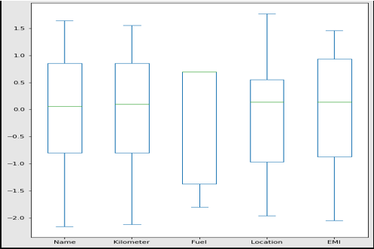
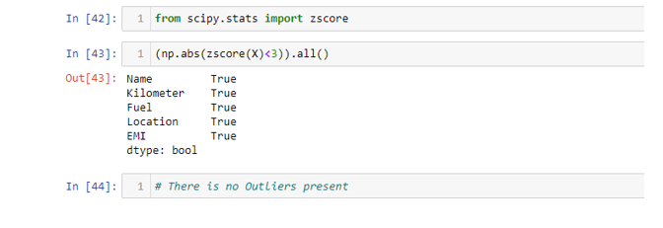
Detecting Outliers: Plotting BarPlot:
ZSCORE
There is no outliers present in the data

Slide 14
Model/s Development and Evaluation
(Linear Regression, Decision Tree Regressor, Random Forest Regressor and Gradient Boosting Regressor)

Slide 15
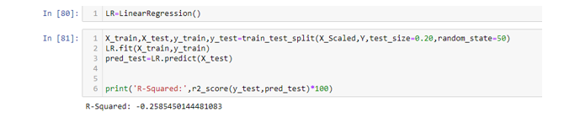
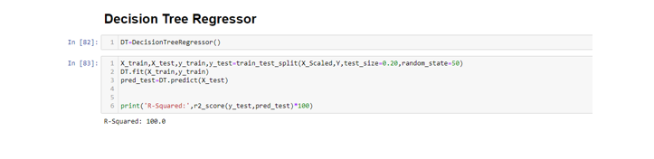
Linear Regression: -25%
Decision Tree Regressor: 100%

Slide 16
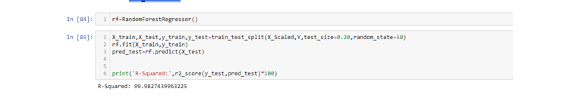
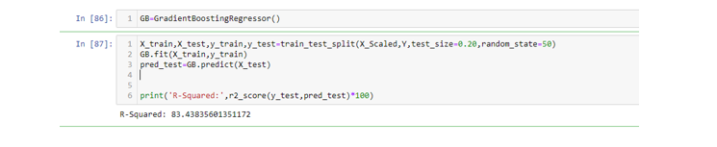
Random Forest Regressor:99.98%
Gradient Boosting Regressor:83.43%

Slide 17
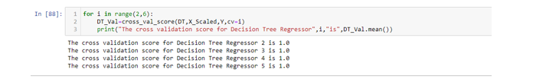
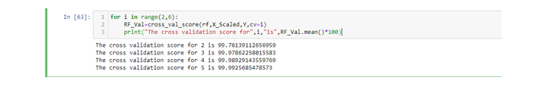
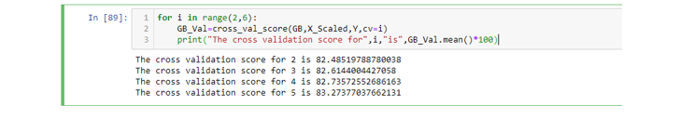
After getting the r squared scores for all the models, it needs to be checked whether any one of them are overfitted, hence cross validation technique has been used. As score for Linear Regression is extremely poor hence only taking Decision Tree, Gradient Boosting and Random Forest Regressor for cross validation
Cross Validation for RF
Cross Validation for DT
Cross Validation for GB

Slide 18
As none of the models are overfitted, and based on the r squared score and cross validation scores, As none of the models are overfitted, and based on the r squared score and cross validation scores, Decision Tree Regressor model is best for this dataset. As the score is already 100, hence hyper parameter tuning is not performed

Slide 19
Conclusion

Slide 20
Key Findings: In this data none of the features had any specific correlation with the car pricing. However, our model Decision Tree Regressor has given an excellent performance in such a big dataset and it has performed consistently throughout the Training and Testing process. Our goal of the project was to create a model that was able to estimate the price of used cars and we achieved it.

